Slide 1
Mental Health in Tech and its Cost
Presentation and coding by:
JR Costa

Slide 2
Intro
Mental Health is one of the least addressed issues
Over 50% will suffer from Depression at some point in Life
Tech can be isolating, non-social, and involves lots of staring at a screen which can exacerbate issues
How much does this affect both the productivity and value of tech companies?

Slide 3
Data Cleaning
We need to organize and clean all the Data together to find out what can be used.
Each Data set involves different values and some involve all productivity in the US labor market.
4 Different Data sets were Used
1 from Kaggle
2 from open code
1 from US dept. of Labor

Slide 4
Data Wrangling
So for all the data sets cleaning and organizing is needed.
Extraneous information unrelated to the questions at hand should be cleaned
One data set needs to be isolated for tech.

Slide 5
Analysis
First we need to find out some background info about each of the Data set.
For the mental health files we need to look at the demographic data, how often it affects their work, where they are, and work conditions
For the US labor data we need to look at the productivity in tech and the change in the years of production
For the global productivity data we need to find the productivity per hour

Slide 6
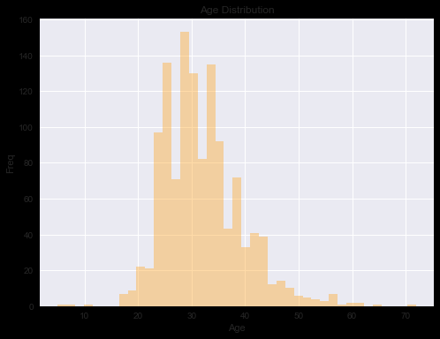
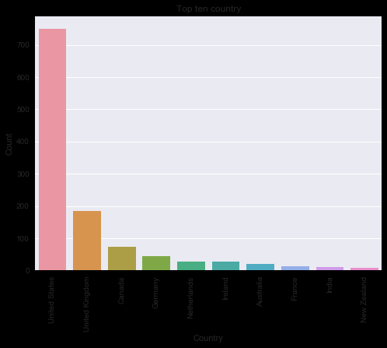
Age and Location Breakdown

Slide 7
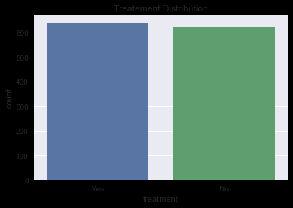
Treatment Distrubtion

Slide 8
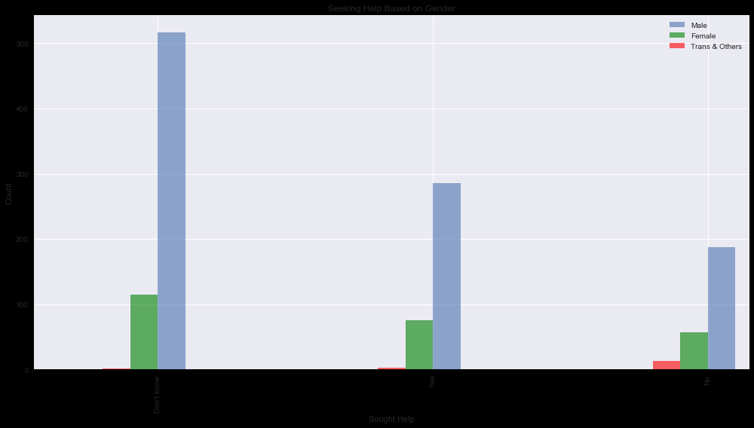
Gender Breakdown

Slide 9
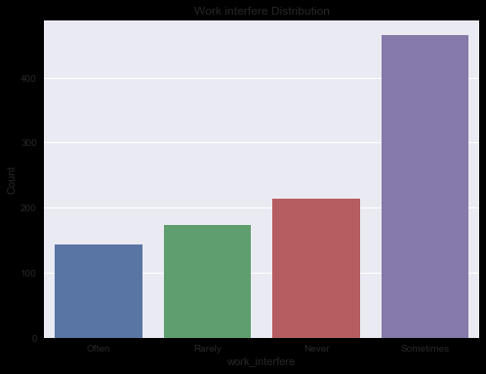
Occurrence of Work Interference

Slide 10
Machine Learning
We will also analyze the tech and reporting data in order to find out how likely someone is to have a health issue and the odds that it will affect their work
Also we will find the highest causes for the mental health issues

Slide 11
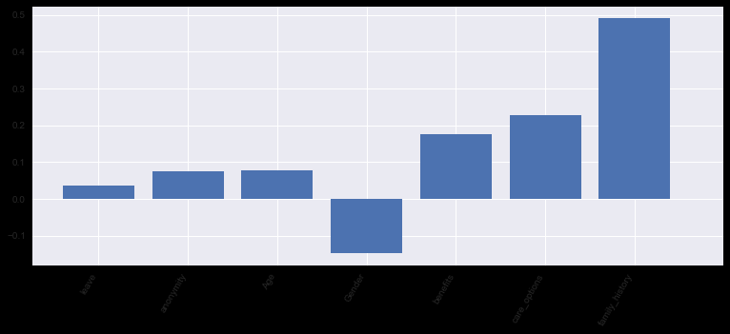
Indicators of Mental Health

Slide 12
Finding the Cost
In order to Find the mental cost of Mental health in Tech we need to find first the amount of workers in the field which we find from the US Labor Statistics
Next find amount that are affected
Then calculate the rate of interference
Finally calculate cost of interference.

Slide 13
The Values
Employees in tech 30,150,000
% that seek treatment : 53
Hours produced : 55,230,000
Total $ generated: 3,378,640,000,000
$ generated per hour: 6117.4
% workers that Mental health affects work: 65.6

Slide 14
Conclusions
As we have seen the rate of mental health is very prevalent
The most common factors affecting mental health are
It seems availability of coverage does help maintain both work interference and treatment
It has a large factor affecting overall productivity by
Gender plays a role in both affliction, treatment, and interference amount
Estimated loss: $4,905,375.26

Slide 15
Conclusions
With the rate of growth and the continued underrepresentation of admitting and reporting the cost of mental health will continue to rob millions and billions of dollars in the tech industry.

Slide 16
Margins of Error and Further Study
As with all self reporting data reporting bias can factor in as people do not want to admit issues they have or how much it affects them
Codifying any reporting data can have issues in the integer values and can either cause over or underestimation
Some areas of further study would be to look at global data as a whole to get a more comprehensive data and with the productivity data find other industry reports on mental health

Slide 17
Bibliography
Data provided by the following sources:
US Bureau of Labor
IN OUT World organization
National Association of Mental Health
Kaggle

